Slide 1
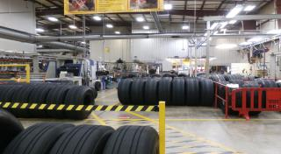
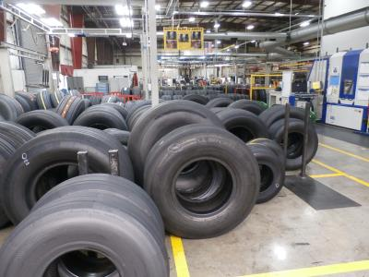
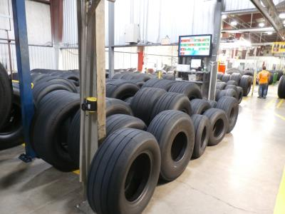
Poor flow in After Cure Rtd Adam Herrman March 16th 2018
Notes:
20

Slide 2


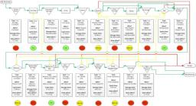
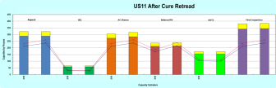
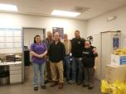
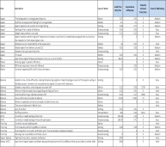


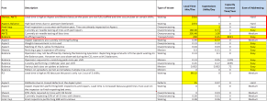

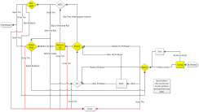

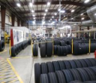
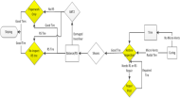

Poor flow in After Cure Rtd
D
M
Results
A
C
I

Slide 3
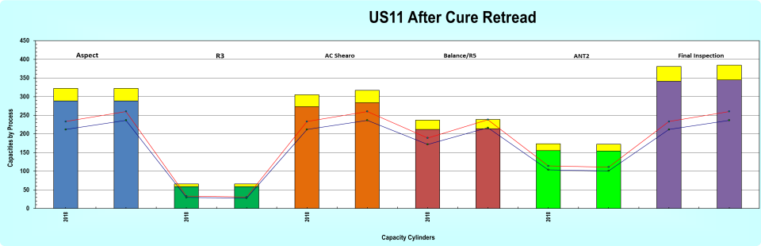
Business Case
Radial demand for retread is projected to increase from 43195 tires in 2017 to 59188 tires in 2021. In order to meet the demand the bottleneck must be removed from the after cure area.
Excessive inventory build up in all after cure posts is causing storage areas to overflow, in spite of the staffing and capacity models showing after cure should be able to keep up with current demand.
Define
Measure
Analyze
Improve
Control

Slide 4
Problem Definition
The current average lead time in After Cure is 4942 min per tire. There are excessive inventory levels at all posts.
Current capacity at the Balance post without break relief is 214tires/day. Will need to be 239tires/day by 2021.
Define
Measure
Analyze
Improve
Control
Notes:
AC RTD should not have high levels of lead time because all the posts currently have the machine capacity to keep up with demand and besides shearo equipment is cheap.
20

Slide 5
Project GOAL
2 Suppressions (save $148,000.00/year)
Increase Balance CMA from 53,714tires/year to 59,989tires/year
Decrease lead time from 4991min/tire to 3000min/tire
Define
Measure
Analyze
Improve
Control

Slide 6
Why: To clarify the customers and needed outputs
Results: Established our high level process and set our boundaries for the group
SIPOC
Define
Measure
Analyze
Improve
Control
Notes:
20

Slide 7
Flow
Define
Measure
Analyze
Improve
Control
Notes:
Describe the Flow
20

Slide 8
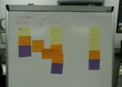
Why: To get clarity on the customer feedback and key requirements
Results: Production customers are affected due to lack of material. NC is the main cause
voc
Conforming Retread Tire
Bottleneck CMA
Output
CTQ
Indicator
Required Level
Current Level
214 tires/day
238 tires/day
Lead Time
3000 min/tire
4991 min/tire
Leak Rates
Quality
tires/month
tires/month
83.6%
Staffing
TRO
>85%
Cost
31 operators
29 Operators
On Time Delivery
TREL
Correct Tires
WIP
1000 tires
1683 tires
Interview with:
RTD Shop Manager, CLF Business Unit Leader, AC Business Unit Leader, QO Tech, RGTE, FP Retread, Operators
Define
Measure
Analyze
Improve
Control
Notes:
20
6/7/2017

Slide 9
VSM → VA / NNVA/ NVA
Why: To understand the current process and identify the wastes
Results: Very few steps in CAI Cutter are VA. (Cut NC, Make Joints, Apply RFI)
Define
Measure
Analyze
Improve
Control

Slide 10
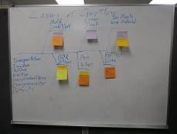
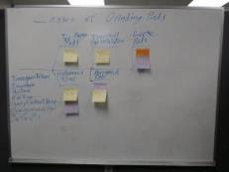

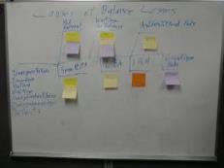
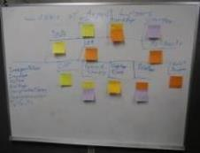
Team brainstorming for wastes
Why: Identify possible root causes X´s
Results: Input to waste hunting
Define
Measure
Analyze
Improve
Control
Notes:
Focused on Aspect because it showed the highest lead time
Focused on Balance because it was the bottleneck
RCAs on Aspect Downtime and Balance Downtime with the operators at the RPP and with the Greenbelt Team
Collected Downtime on HRxHR charts
20

Slide 11
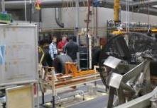
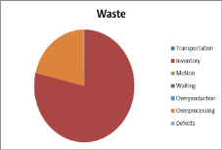
Waste hunting
Why: Identify the principals wastes (X´S)
Results: Define possible X´s
Define
Measure
Analyze
Improve
Control

Slide 12
Prioritization of Causes (X’s)
After the analysis of the VSM, waste hunting and the data collection, the team choose 4 main causes through a prioritization matrix
All the wastes were prioritized, top 6 are shown below
Define
Measure
Analyze
Improve
Control

Slide 13
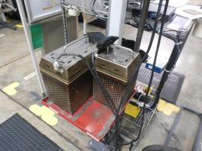
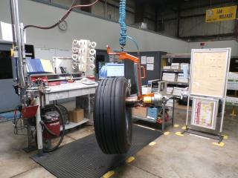
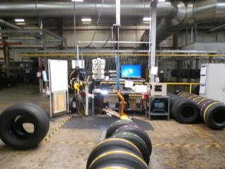
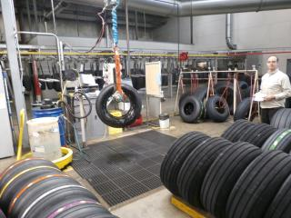
Non Value Added Inspections – Benchmarking / Value Added Analysis
Remove requirement for 100% ANT2 for R5 repairs
Remove requirement for 100% ANT2 for Bias tires
No counter verification at Final Inspection
Hotline Inspection
Define
Measure
Analyze
Improve
Control

Slide 14
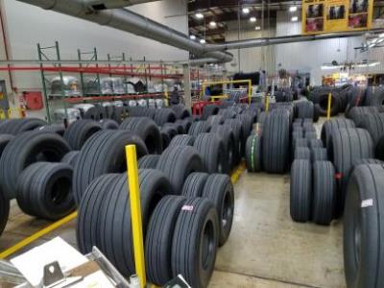
Bottleneck Flow - Continuous Observation
Shuffling Inventory (not respecting lanes)
Picking high priority tires out of inventory (not respecting FIFO
Large amounts of time entering data into LEA
1 set of rollers per spreader
ROLLING TIRES OFF SPREADER (SAFETY!!!)
Non standardized bolt sizes on balance spiders
Long 5 minute briefing
During the observation 0% of the time was spent waiting on the balancers or spreaders. Even with 3 Balancers.
Define
Measure
Analyze
Improve
Control

Slide 15
Lack of Staffing - Test of Bottleneck Kanban System / Training matrix
Tested new rules for managing inventory at the bottleneck and monitored the results.
If Balance inventory has over 3 lanes full increase balance staffing to 3 until one lane is full
If less that lane if full at balance increase shearo staffing to 1 until 3 lanes are full
If balance is staffed at 2 or more increase staffing at Final Inspection to 2
When this plan was tested we found that:
Final Inspection was bottlenecked due to a lack of trained personnel
Shearo inventory overflowed if Shearo was shut down to fully staff balance
Red indicates lack of trained personnel
Define
Measure
Analyze
Improve
Control

Slide 16
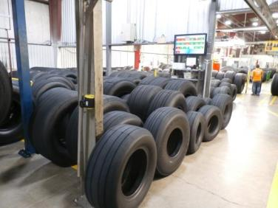

Partial Staffing -Test of Bottleneck Kanban System / training matrix
Aspect, R3, Shearo, and ANT2 are not fully staffed because they can outrun the bottleneck.
R3 and ANT2 are staffed less than once a shift.
Not every crew has enough personnel trained on these posts to run them when the inventory overflows.
Inventory at these posts is allowed to pile up excessively before the post is run, creating flow issues and high lead times.
Define
Measure
Analyze
Improve
Control

Slide 17
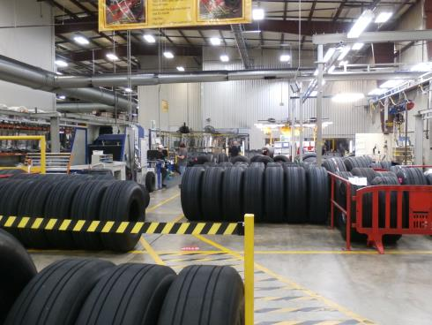

improvements - Difficulties of Pull System in After cUre Retread
Warehouse is over 1 hour away.
Tires are moved individually by hand.
24 separate tires sizes running each month.
Inventory space is very limited because tires are stored on the floor.
Tires must wait 1 hour after curing before passing through Shearo.
In order to produce a retread tire, a worn casing must first return from the field.
Because of these issues all tires that come out of curing must be process.
Tires must be processed in FIFO, picking specific tires from the inventory is extremely time consuming.
Define
Measure
Analyze
Improve
Control
Notes:
AC has the machine capacity to keep up with curing and except for post capacity the equipment is cheap
20

Slide 18
improvements - Solutions
Define
Measure
Analyze
Improve
Control
Notes:
20

Slide 19
improvements – Flow (Current)
Red indicates lack of trained personnel
Define
Measure
Analyze
Improve
Control
Notes:
Train more operators on Final Inspection and move paperwork to un-bottleneck the post
Use Kanbans and train more operators on Balance and Shearo to push the bottleneck back further (Shearo operator should not be the third balancer)
Test Hotline inspection and Suppress ANT2 to reduce complexity and free staffing
4 combine Final Inspection and ANT2, Combine R1 and R3 so inventory does not build up
20

Slide 20

improvements – Flow (Improved)
Tires must cool for 1 hour after curing before going through Shearo
Yellow cells indicate training needed
Define
Measure
Analyze
Improve
Control
Notes:
20

Slide 21

cONTROL
Kanban Lanes/Fast lane at the Bottleneck
Staffing priorities and triggers on the Action Matrix on the HRxHR Charts
N1 Delivery Panel tracking disruptions to staffing post
N2 Delivery panel tracking WIP
Tracking polyvalency, absentee subs, and surge capacity in the staffing model and review each month with the shop
Define
Measure
Analyze
Improve
Control

Slide 22
Results (Timeline)
Notes:
20

Slide 23
Gains
Notes:
20

Slide 24

Key learning points
The majority of wasted time is not a part of the cycle time (transportation, inventory, waiting, overproduction, defects)
Do not assume any part of the process is necessary.
Set clear priorities and triggers for when to staff each post. Start at the end of the production line and work backwards. Experiment.
Always keep the goal in mind.

